Slide 1
The Limits to Growth: Sustainability and the Circular Economy
Lecture 0: Organization
Prof. Dr. Benjamin Leiding
M.Sc. Anant Sujatanagarjuna
M.Sc. Nelly Nicaise Nyeck Mbialeu

Slide 2
License
This work is licensed under a Creative Commons Attribution-ShareAlike 4.0 International License. To view a copy of this license, please refer to https://creativecommons.org/licenses/by-sa/4.0/ .
Updated versions of these slides will be available in our Github repository.

Slide 3
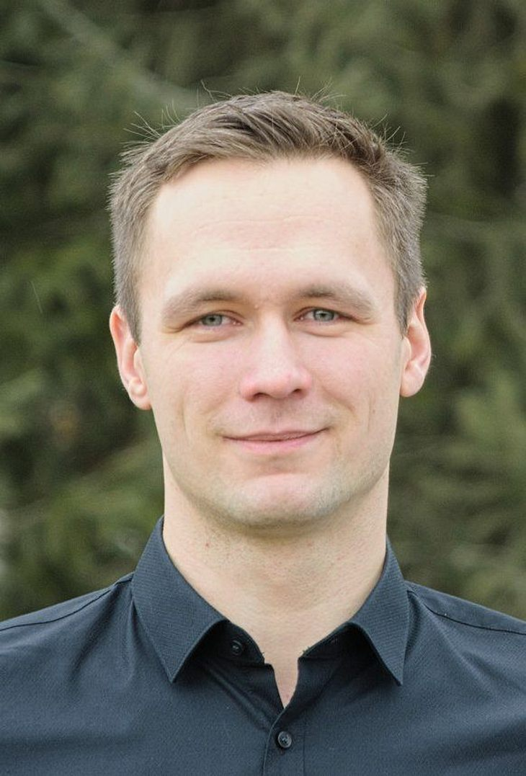

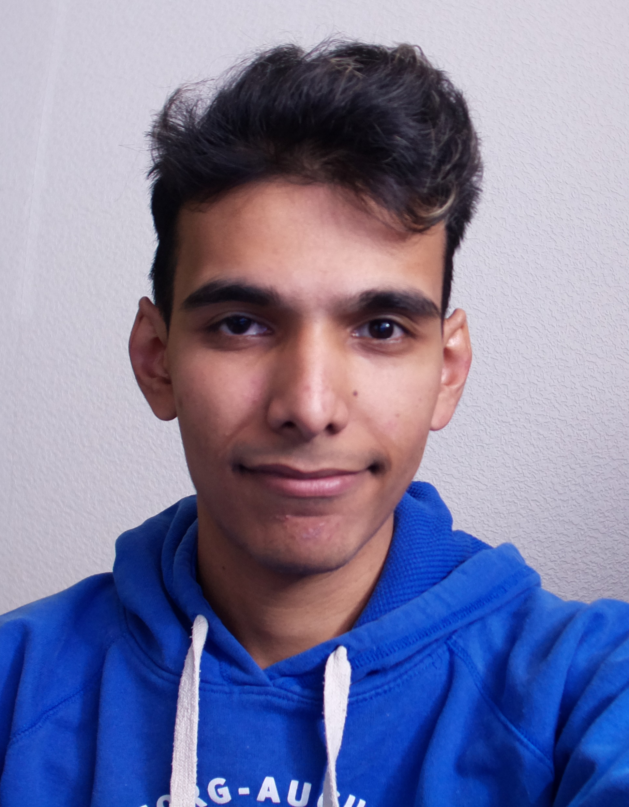
Team
Prof. Dr. Benjamin Leiding
benjamin.leiding@tu-clausthal.de
M.Sc. Nelly Nicaise
Nyeck Mbialeu
nelly.nicaise.nyeck.mbialeu@tu-clausthal.de
M.Sc. Anant Sujatanagarjuna anant.sujatanagarjuna@tu-clausthal.de

Slide 4
Research Group
Emerging Technologies for the Circular Economy → ETCE
Research focus:
Intersection of IT and sustainability
Circular Economy
Self-organized, decentralized and distributed systems
Machine-to-Everything Economy (M2X Economy)
Other courses:
Requirements Engineering (WS – M.Sc.)
Emerging Technologies for the Circular Economy (SS – M.Sc.)
Notes:
<number>

Slide 5
Research Group
ETCE Website – Link
Course material
Theses/project topics
Our research in action:
ZDF documentary (German) – Link
Klartext Preis 2020 (German) – Link
You want join us? Write us an email!
→ benjamin.leiding@tu-clausthal.de
Notes:
<number>

Slide 6
Research Group
ETCE Website – Link
Course material
Theses/project topics
Our research in action:
ZDF documentary (German) – Link
Klartext Preis 2020 (German) – Link
You want join us? Write us an email!
→ benjamin.leiding@tu-clausthal.de
Notes:
<number>

Slide 7
Course Content
Basics of climate change, environmental pollution, and dwindling non-renewable resources
Introduction to the circular economy, sustainability, and related concepts (biocapacity, etc.)
Sustainability goals
Feedback loops and tipping points
Implications of closed systems with a finite supply of resources
Technology-focused and technology-critical approaches towards sustainability
Circular Societies
Notes:
<number>

Slide 8
Learning Outcome
Understanding the concept of a circular economy, sustainability, and related concepts (biocapacity, etc.).
Gain a basic understanding of causes, dimensions, and the characterization of climate change, environmental pollution, and dwindling non-renewable resources.
Being able to make high-level, transdisciplinary assessments of decisions and measures in a social, economic, and political context.
The ability to critically assess upcoming technological solutions enabling/facilitating sustainability and the circular economy.
Notes:
<number>

Slide 9
Lecture Plan
Date | Lecture Title
30.10.2024 | L00 – Organisation L01 – Introduction
06.11.2024 | L02 – Challenges I – Climate Change
13.11.2024 | L03 – Challenges II – Environmental Pollution and Resources
20.11.2024 | L04 – A History of Political (In-) Action (Flipped Classroom → MOOC@Home + Live Lecture)
27.12.2024 | L05 – Overshoot, the Limits to Growth and Planetary Boundaries
04.12.2024 | L06 – LifeCycle Assessment (LCA) (Flipped Classroom → MOOC@Home + Live Lecture)
11.12.2024 | L07 – Ethics and Morals of Sustainability
18.12.2024 | L08 – Circular Economy (Flipped Classroom → MOOC@Home + Live Lecture)
08.01.2025 | L09 – Circular Societies (MOOC)
15.01.2025 | L10 – Beyond the Circular Economy I
22.01.2025 | L11 – Invited Lecture (Gabriel from the CatFarm project)
29.01.2025 | L12 – Beyond the Circular Economy II
05.02.2025 | L13 – Complex Societies and Technology L14 – Summary
12.02.2025 | Exam Q&A
MOOC == Watch@Home

Slide 10
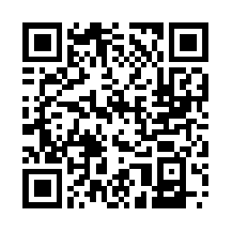
Course Organization
Course website – Link
News and updates:
Everyone: Please join the public Matrix room by using this Link: https://matrix.to/#/#public--LTG-Course-SS23:matrix.org
We will share news and updates here and you will also have the chance to ask questions to us and your fellow students.
CLZ students + DigiTec will additionally receive information via StudIP (Link)
Slides will be uploaded to Github (Link)
Please report bugs ;)
Lecture recordings will be available on StudIP and on Github
Questions? Write us an email: etce-ltg@tu-clausthal.de ← We will only respond to emails written to this specific email address!

Slide 11
Course Organization - Asynchronous Learning & MOOC content
Massive Open Online Course
Remote and (often) asynchronous online courses not just for students enrolled in a specific university, but ideally open for everybody
Usually consist of pre-recorded lectures, interactive content and online quizzes
Some of you might have visited MOOC on platforms such as edX, LinkedIn Learning, Coursera, Udacity, etc. before
We are currently developing a MOOC for the Limits to Growth Lecture
This semester will be a test run for this asynchronous and digital learning content
We are very happy about any feedback you can give us to improve the course further! Just write us an email: etce-ltg@tu-clausthal.de

Slide 12
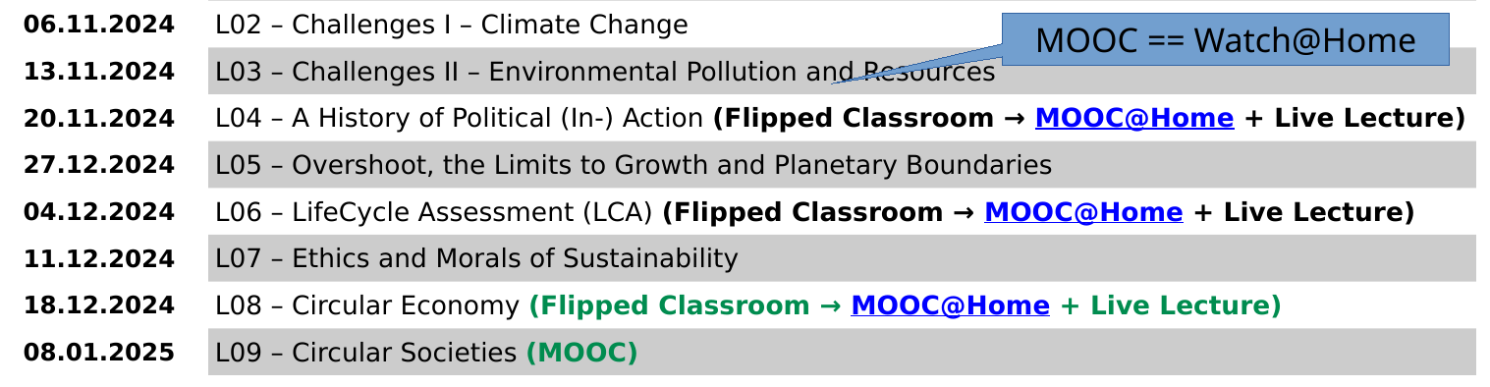
Course Organization – Asynchronous Learning
This semester we will include asynchronous learning for some of the lectures
Consisting of short pre-recorded videos and interactive content
You will get further information about these two sessions during the semester
You will find the lecture videos on the course website
The MOOC lectures will not be live lectures. Instead, you will find pre-recorded videos and other content on our website.

Slide 13
Dates/Times/Locations
Lecture:
Wednesday 1:15 pm to 2:45 pm (Berlin time) – 30.10.2024 to 05.02.2025
Location: Goslar Gotec (Am Stollen 19 C, 38640 Goslar, Germany) or via BigBlueButton (Link)
Exercise / Q&A:
Wednesday 3:00 pm to 4:00 pm (Berlin time) – 30.10.2024 to 12.02.2025
Location: Goslar Gotec (Am Stollen 19 C, 38640 Goslar, Germany) or via BigBlueButton (Link)

Slide 14
Exercises
Individual work → no group submissions
Submission of each exercise is mandatory
You pass by submitting an exercise – even if it is an empty page
You will receive feedback on your submission
Exercise = learning feedback
Some exercises require you to submit your work. All such exercises should be submitted the following link, using password “LTG2425”:
https://tucloud.tu-clausthal.de/index.php/s/KGQqI0R6VoPwtNY
We do not accept email submissions, please use the file drop link to upload your submissions.
Important: Always include your full name, your student email address and your student ID, so that we can track your submission.

Slide 15
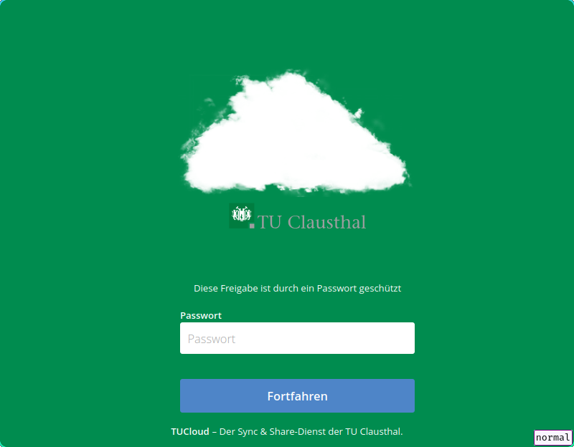
Exercises
Submission Instructions
Step 1: Enter the password, “LTG2425”
etc. follow on the next slides (Examination)

Slide 16
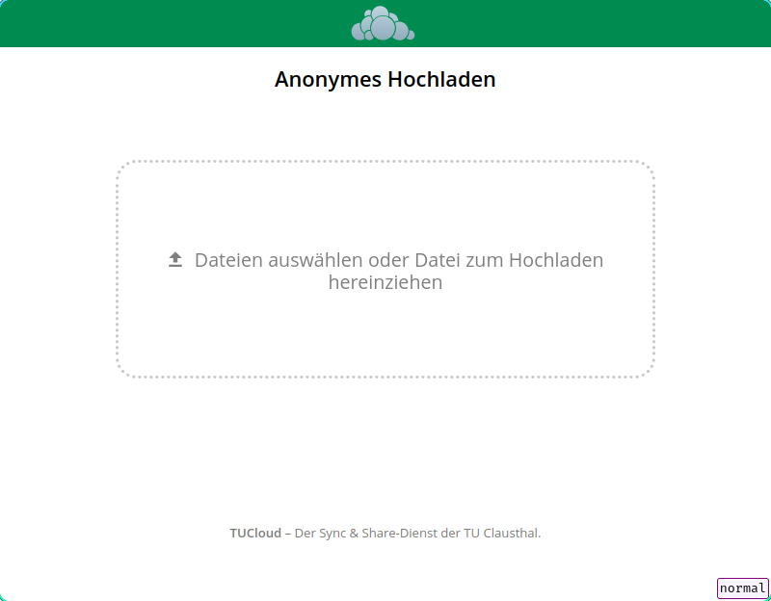
Exercises
Submission Instructions
Step 2: Upload a file, e.g. “E01-My_Name.pdf”
Once you upload a file, you cannot delete it
Unless otherwise specified, we only accept PDF files.
Ensure that your full name, and the exercise is mentioned in the filename AND inside the PDF file itself.
In addition, please include your student email address in the pdf file.
etc. follow on the next slides (Examination)

Slide 17
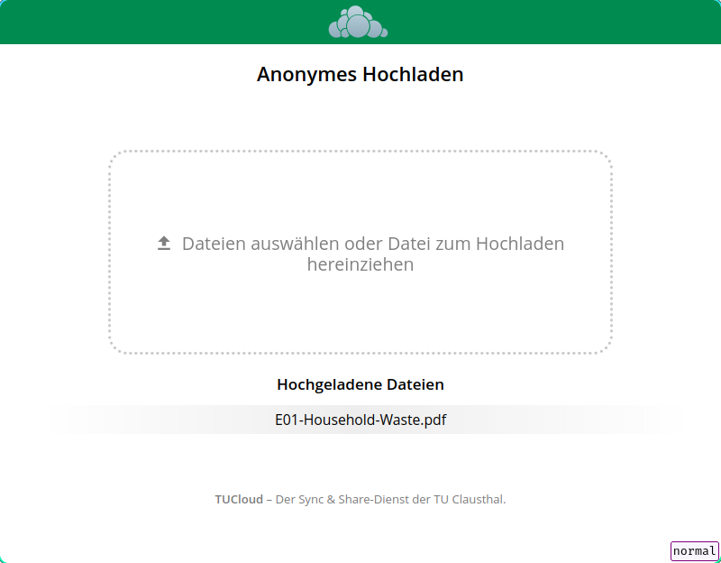
Exercises
Submission Instructions
Step 3: If your exercise was successfully uploaded,it will be visible. Please do not upload duplicates.
etc. follow on the next slides (Examination)

Slide 18
Examination
Prerequisite for admission to the final exam (all criteria have to be fulfilled):
Submit all exercises
Final exam:
Most likely on the 19.02.25 - 21.02.25
Either written exam (120min) or oral examination (20-25min)
Note for external students → You do not have to register as a guest at TU Clausthal! You pass the exam and get a written confirmation from us which you can present to your local examination office.

Slide 19
Examination
Prerequisite for admission to the final exam (all criteria have to be fulfilled):
Submit all exercises
Final exam:
Most likely on the 19.02.25 - 21.02.25
Either written exam (120min) or oral examination (20-25min)
Note for external students → You do not have to register as a guest student at TU Clausthal! You pass the exam and get a written confirmation from us which you can present to your local examination office.

Slide 20
Self-Study Star
Slides with the self-study star indicate optional/additional study material that is not mandatory but could be helpful or interesting
Self-Study Star →

Slide 21
Literature
This course is not based on a single book and you do not need to buy a book to pass the exam.
Donella H. Meadows, Jorgen Randers, and Dennis L. Meadows. The Limits to Growth (1972).
Donella H. Meadows, Jorgen Randers, and Dennis L. Meadows. Limits To Growth: The 30-Year Update (2004).
Baccini et al. Metabolism of the Anthroposphere: Analysis, Evaluation, Design (2012).
Walter R. Stahel. The Circular Economy: A User's Guide (2019).
XR. This is not a Drill (2019)
W. Brian Arthur. The Nature of Technology: What It Is and How it Evolves (2011).
David Wallace-Wells. The Uninhabitable Earth, Annotated Edition (2017).
James Lawrence Powell. The 2084 Report: An Oral History of the Great Warming (2020).
Joseph Tainter. The Collapse of Complex Societies (1988).

Slide 22
Literature
(German) Stefan Rahmstorf, Hans Joachim Schellnhuber. Der Klimawandel (2019).
David Archer, Stefan Rahmstorf. The Climate Crisis (2010).
Gabrielle Walker, David King. The Hot Topic: How to Tackle Global Warming and Still Keep the Lights on (2008).

Slide 23
Further Resources
Climate University – Teaching and learning for a sustainable future – Link
Circular Societies (German) – Link
Server Infrastructure for a Global Rebellion – Link

Slide 24
Questions?

